Slide 1
The Letter from James - Chapter 3

Slide 2
If anyone does not stumble in word, he is a perfect man, able also to bridle the whole body.
(James 3:2)

Slide 3
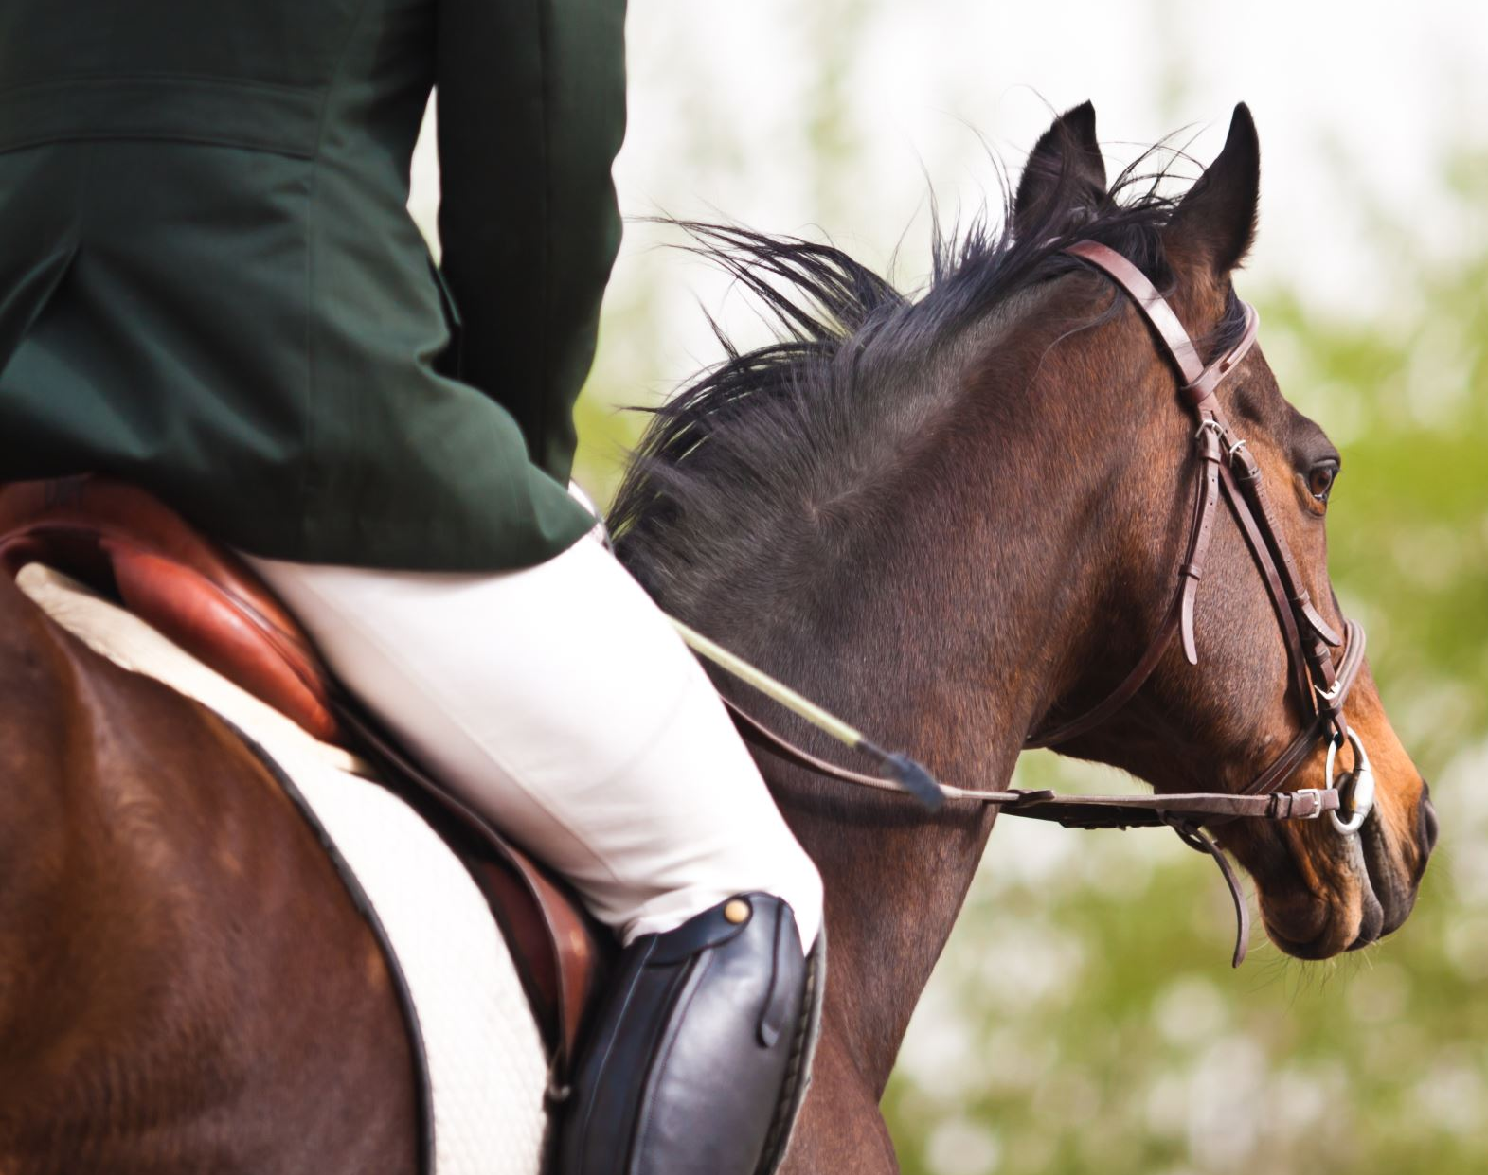
We put bits in horses' mouths that they may obey us, and we turn their whole body. (James 3:3)

Slide 4
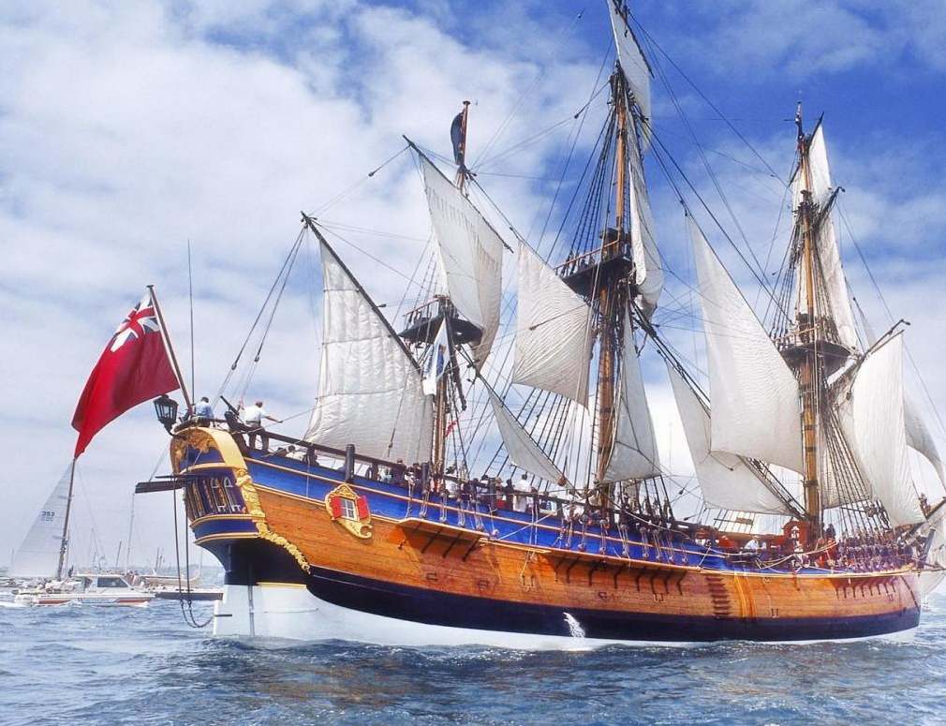
Look also at ships: although they are so large and are driven by fierce winds, they are turned by a very small rudder wherever the pilot desires. (James 3:4)

Slide 5
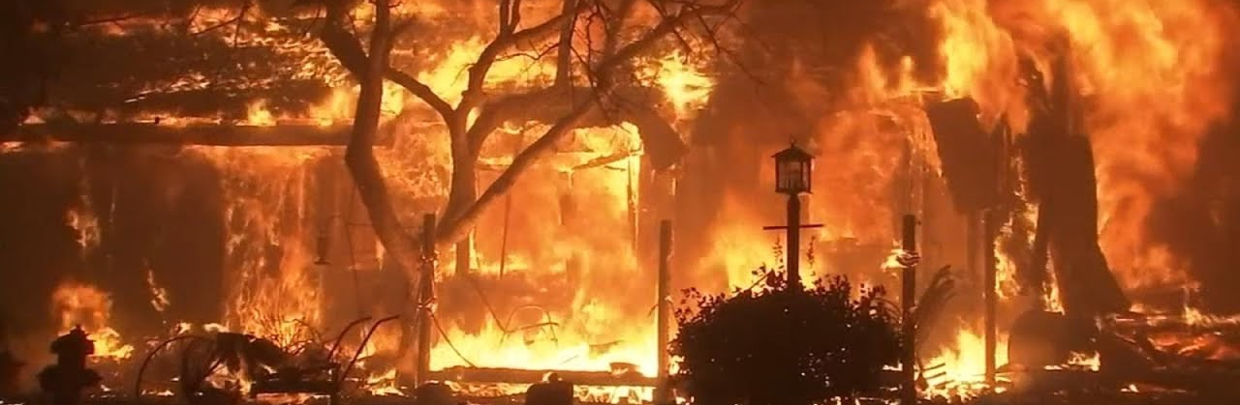
The tongue is a fire, a world of iniquity. The tongue is so set among our members that it defiles the whole body, and sets on fire the course of nature; and it is set on fire by hell. (James 3:6)

Slide 6
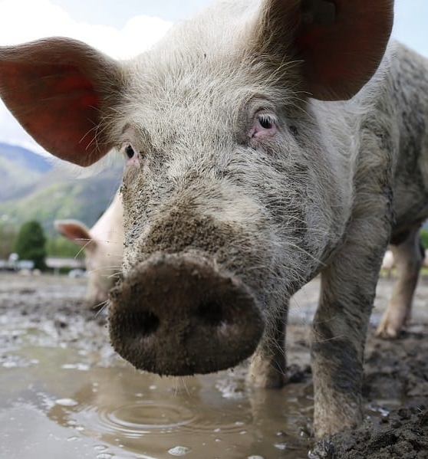
For every kind of beast and bird, of reptile and creature of the sea, is tamed and has been tamed by mankind. But no man can tame the tongue. It is an unruly evil, full of deadly poison. (James 3:7-8)

Slide 7
Where do our words come from?
Those things which proceed out of the mouth come from the heart, and they defile a man. For out of the heart proceed evil thoughts, murders, adulteries, fornications, thefts, false witness, blasphemies. These are the things which defile a man… (Matthew 15:18-20)
A good man out of the good treasure of his heart brings forth good; and an evil man out of the evil treasure of his heart brings forth evil. For out of the abundance of the heart his mouth speaks. (Luke 6:45)

Slide 8
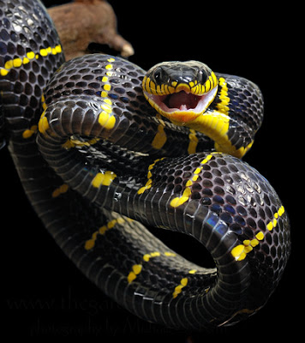
If you want to know what is in a person’s heart, listen to what comes out of their mouth.

Slide 9
What comes out of your mouth?
What have you spoken this morning?
What did you speak yesterday, and the day before, and the day before that?

Slide 10
I say to you that for every idle word men may speak, they will give account of it in the day of judgment. For by your words you will be justified, and by your words you will be condemned. (Matthew 12:36-37)
For out of the abundance of the heart the mouth speaks.
(Matthew 12:34)

Slide 11
This is a faithful saying … Christ Jesus came into the world to save sinners
(1 Timothy 1:15)

Slide 12
Out of the same mouth proceed blessing and cursing. My brethren, these things ought not to be so.
(James 3:10)
Old Nature | New Nature
Cursing | Blessing
Bitter water | Fresh water
Bad fruit | Good fruit
Thornbushes and thistles | Grape vines and fig trees
You must CHOOSE how you live

Slide 13
… Giving all diligence, add to your faith
virtue,
to virtue knowledge,
to knowledge self-control,
to self-control perseverance,
to perseverance godliness,
to godliness brotherly kindness,
and to brotherly kindness love.
(2 Peter 1:5-7)
The fruit of the Spirit is
love,
joy,
peace,
longsuffering,
kindness,
goodness,
faithfulness,
gentleness,
self-control
(Galatians 5:22-23)
If we live in the Spirit, let us also walk in the Spirit.
(Galatians 5:25)

Slide 14
Choose for yourselves this day whom you will serve…
(Joshua 24:15)

