Slide 1
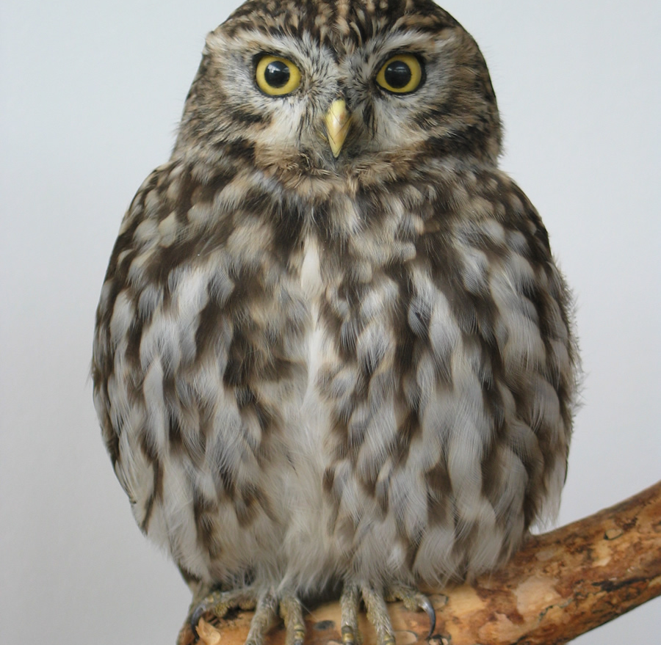
Wisdom
James 3: 13 to 18

Slide 2

Three important questions
What is wisdom?
Where do you see wisdom?
How do you get wisdom?

Slide 3



1. What is wisdom?
Information
Knowledge
Wisdom
What is the value of wisdom?
What is the value of foolishness?

Slide 4
1. What is wisdom?
Information
Knowledge
Wisdom
TWO TYPES OF WISDOM
Wisdom of this world | Wisdom from above
Earthly | Heavenly
Sensual / natural | Spiritual
Demonic | Godly

Slide 5
2. Where do you see wisdom?
In what you think?
In what you say?
In what you do?
Who is wise and understanding among you? Let him show by good conduct that his works are done in the meekness of wisdom. (James 3: 13)

Slide 6
2. Where do you see wisdom?
Wisdom of this world | Wisdom from above
Earthly | Heavenly
Sensual / natural | Spiritual
Demonic | Godly
If you have bitter envy and self-seeking in your hearts, do not boast and lie against the truth. … For where envy and self-seeking exist, confusion and every evil thing are there.
(James 3: 14,16)

Slide 7
2. Where do you see wisdom?
Wisdom of this world | Wisdom from above
Earthly | Heavenly
Sensual / natural | Spiritual
Demonic | Godly
The wisdom that is from above is
  first pure,
  then peaceable,
  gentle,
  willing to yield,
  full of mercy and good fruits,
  without partiality and
  without hypocrisy.
(James 3: 17)

Slide 8
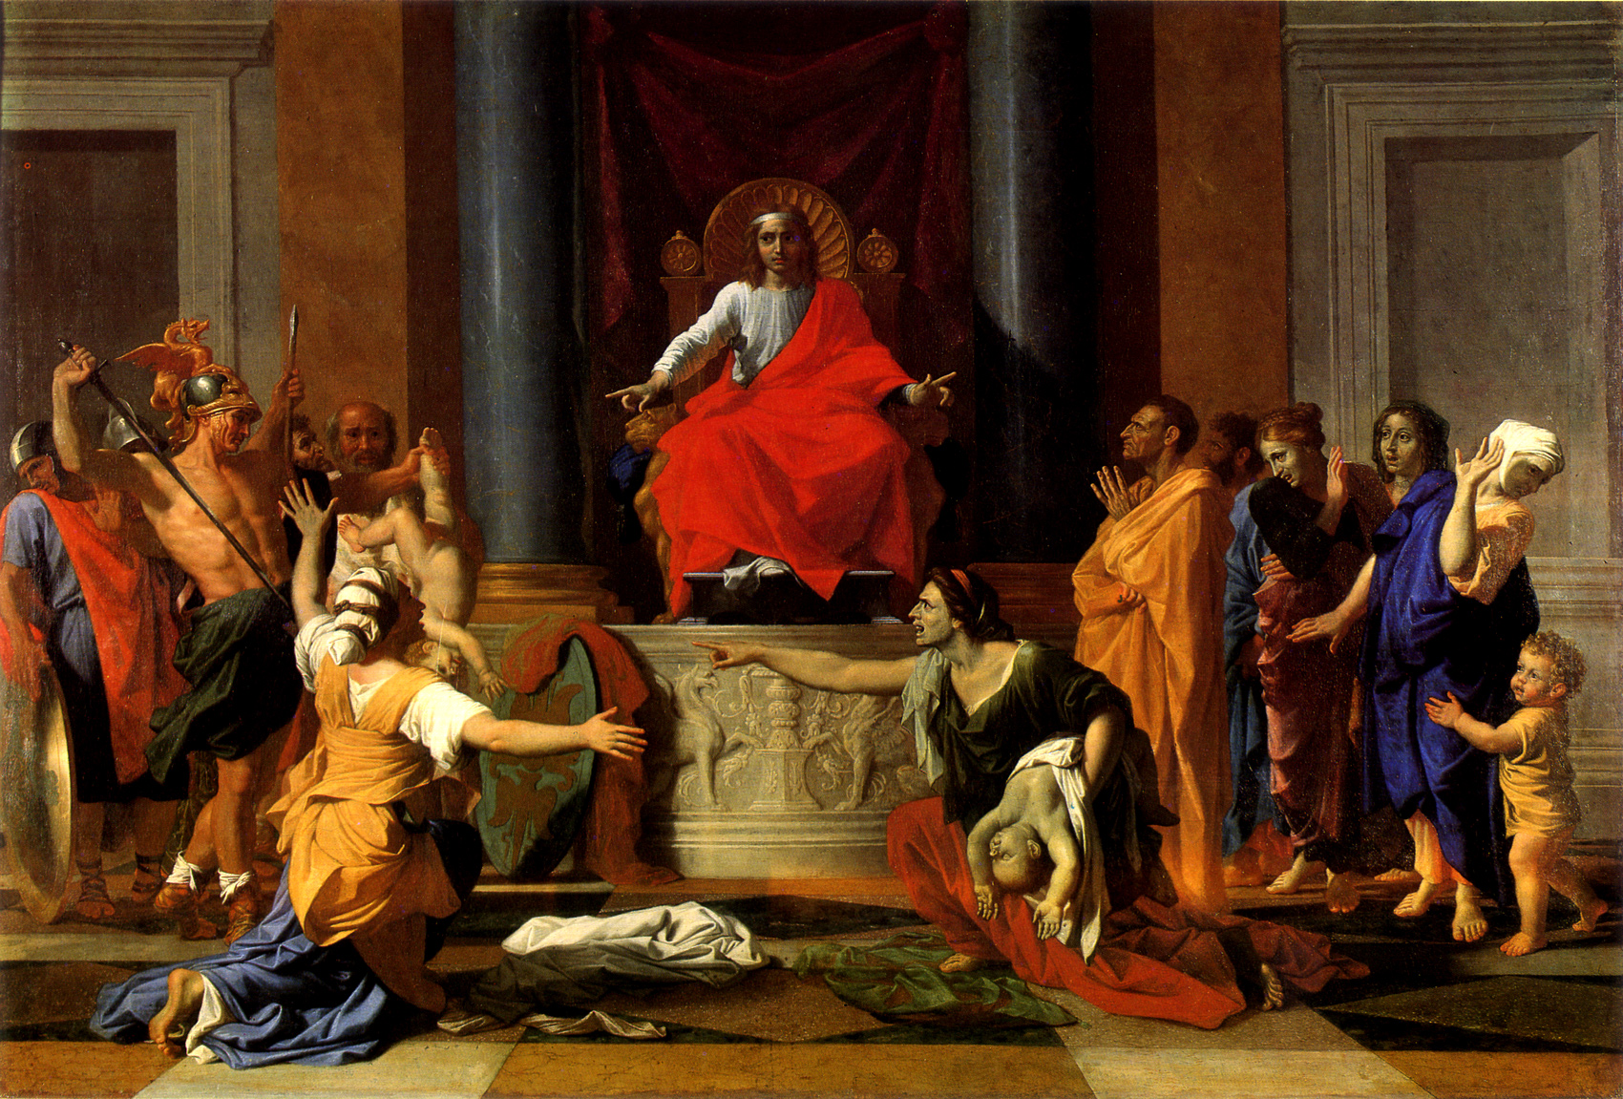
2. Where do you see wisdom?
David
I have more understanding than all my teachers,
For Your testimonies are my meditation.
I understand more than the ancients,
Because I keep Your precepts.
(Psalm 119: 99-100)
Solomon
And all Israel … saw that the wisdom of God was in him. (1 Kings 3: 28)

Slide 9
2. Where do you see wisdom?
The Messiah
The Spirit of the LORD shall rest upon Him,
The Spirit of wisdom and understanding,
The Spirit of counsel and might,
The Spirit of knowledge and of the fear of the LORD. (Isaiah 11: 2)
… and they returned to Galilee, to their own city, Nazareth. And the Child grew and became strong in spirit, filled with wisdom; and the grace of God was upon Him.
(Luke 2:39-40)
Then He went down with them and came to Nazareth, and was subject to them … And Jesus increased in wisdom and stature, and in favor with God and men.
(Luke 2:51-52)

Slide 10
3. How do you get wisdom?
What does James say?
If any of you lacks wisdom, let him ask of God. (James 1: 5)
What does Solomon say?
Get wisdom! Get understanding! (Proverbs 4: 5)

Slide 11




3. How do you get wisdom?
The fear of the LORD is the beginning of wisdom;
A good understanding have all those who do His commandments.
(Psalm 111:10)
The fear of the LORD is the beginning of knowledge,
But fools despise wisdom and instruction.
(Proverbs 1:7)
The fear of the LORD is the instruction of wisdom,
And before honour is humility. (Proverbs 15:33)
The fear of the LORD is the beginning of wisdom,
And the knowledge of the Holy One is understanding. (Proverbs 9:10)

Slide 12

3. How do you get wisdom?
1. Read to understand
2. Believe
3. Live
Your word is a lamp to my feet
And a light to my path.
(Psalms 119: 105)

Slide 13
Wisdom is the principal thing;
Therefore get wisdom.
And in all your getting,
get understanding.
(Proverbs 4: 7)

