Slide 1
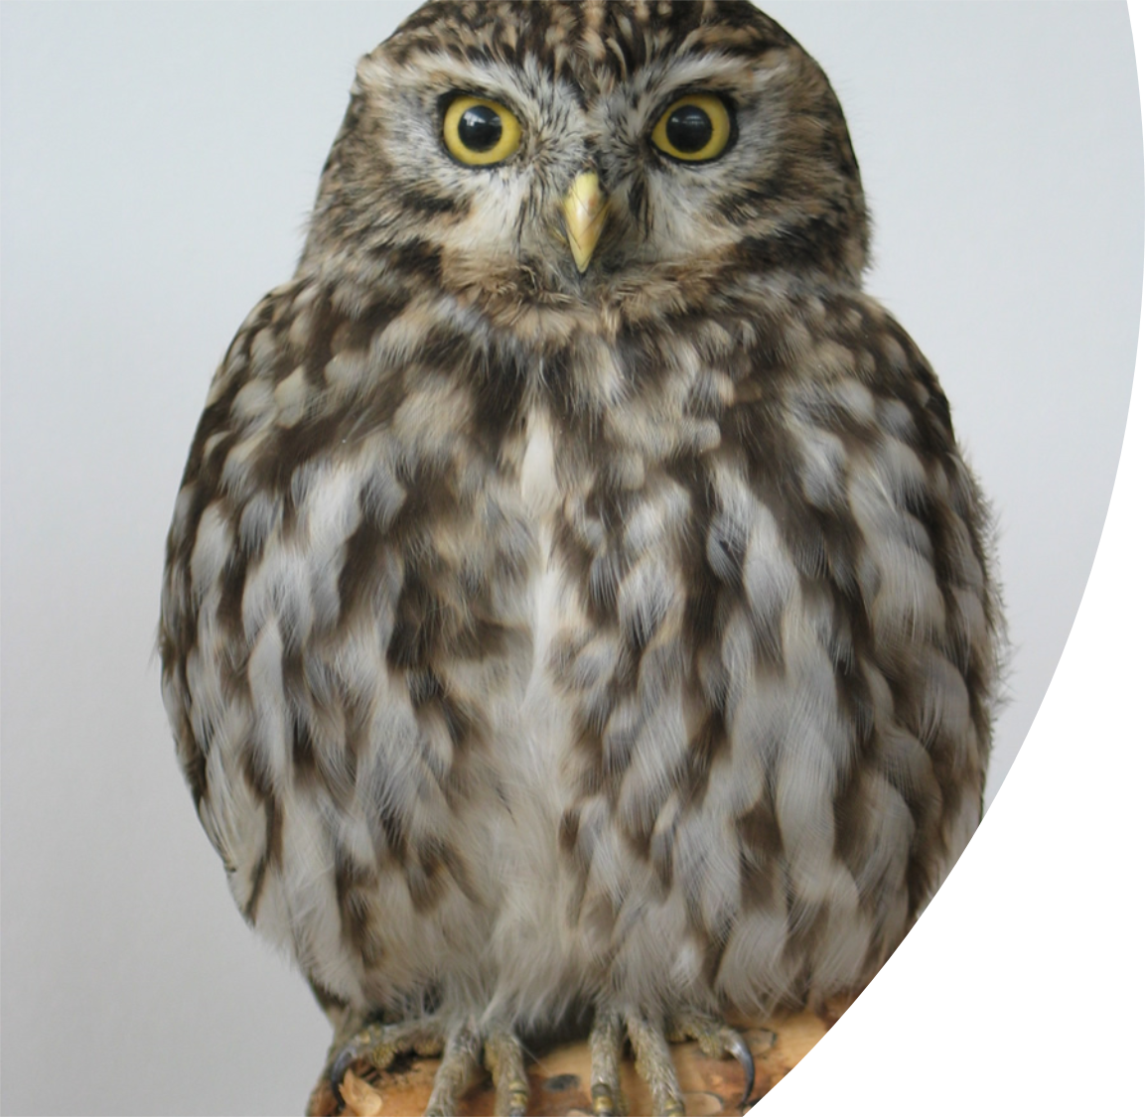
James 5: 1-11
More important wisdom

Slide 2
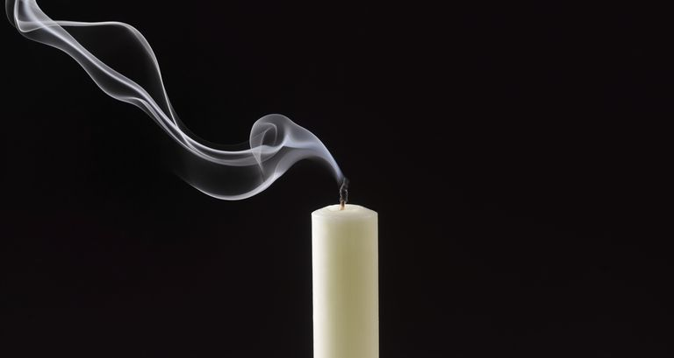
What is your life?
(James 4:14)

Slide 3
The Heart
The heart is the source of all that shapes our life…
Keep your heart with all diligence,
For out of it spring the issues of life.
(Proverbs 4:23)

Slide 4
The Lord Jesus said:
“Woe to you who are rich,
for you have received your consolation.”
(Luke 6:24)
James said:
Come now, you rich,
weep and howl for your miseries that are coming upon you!
(James 5:1)

Slide 5

Problem 1
Do not lay up for yourselves treasures on earth …
For where your treasure is, there your heart will be also.
(Matthew 6:19, 21)
But God said to him, “Fool!”
(Luke 12:20)
But God said to him, “_ _ _ _!”
(Luke 12:20)
So is he who lays up treasure for himself, and is not rich
toward God.
(Luke 12:21)

Slide 6
Problem 2
Will you set your eyes on that which is not?
For riches certainly make themselves wings;
They fly away like an eagle toward heaven.
(Proverbs 23:5)
He who oppresses the poor
to increase his riches,
and he who gives to the rich,
will surely come to poverty.
(Proverbs 22:16)
The blessing of the LORD makes one rich,
and He adds no sorrow with it.
(Proverbs 10:22)

Slide 7
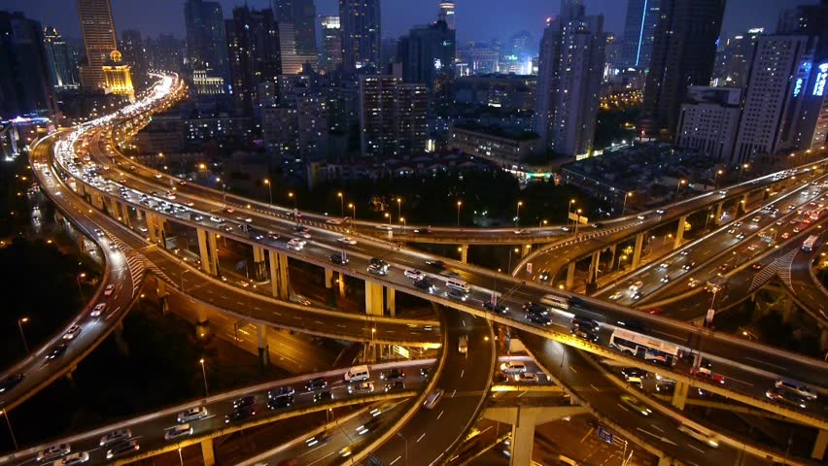
This world,
this life.
The day of the Lord will come
as a thief in the night
(2 Peter 3:10)
Jesus said:
I am the light of the world.
(John 8:12)

Slide 8
The problem for the believers
Therefore,
be patient, brethren,
until the coming of the Lord.
(James 5:7)

Slide 9
Therefore, be patient, brethren, until the coming of the Lord.
(James 5:7)
But when…?
We don’t know the day or the hour (See Matthew 24:36)
It has been soooo long!
    True! (See 2 Peter 3:1-13)
    No one waits more than a lifetime (see Hebrews 9:27)
    He rose again, so He will come again
Therefore, be ready! (Mark 13:33-37)

Slide 10
Another problem for the believers
Do not grumble against one another, brethren…
(James 5:9)
We shall all stand before
the judgment seat of Christ.
(Romans 14:10)
Behold, the Judge is standing at the door!
(James 5:9)

Slide 11
Therefore, be patient, brethren, until the coming of the Lord.
(James 5:7)
A good heart:
Rejoicing in hope,
Patient in tribulation,
Continuing steadfastly in prayer.
(Romans 12:12)

Slide 12
​There was a man in the land of Uz,
whose name was Job;
and that man was blameless and upright,
and one who feared God and shunned evil.
(Job 1:1)
Then, 42 chapters later…
I have uttered what I did not understand,
Things too wonderful for me, which I did not know.
(Job 42:3)
Now the LORD blessed the latter days of Job more than his beginning …
(Job 42:12)

Slide 13
Therefore,
be patient, brethren,
until the coming of the Lord.
(James 5:7)
“Well done, good and faithful servant…”
(Matthew 25:21)

