Slide 1
James 4: 1-10

Slide 2
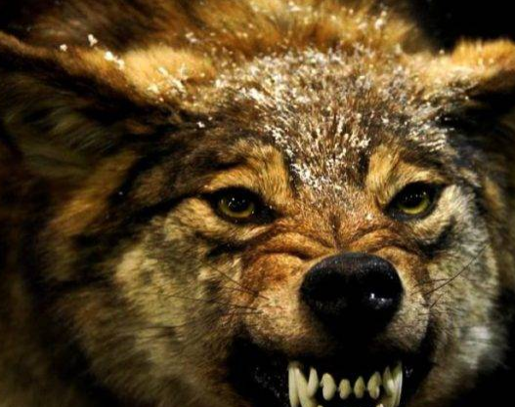
James 4: 1-10

Slide 3
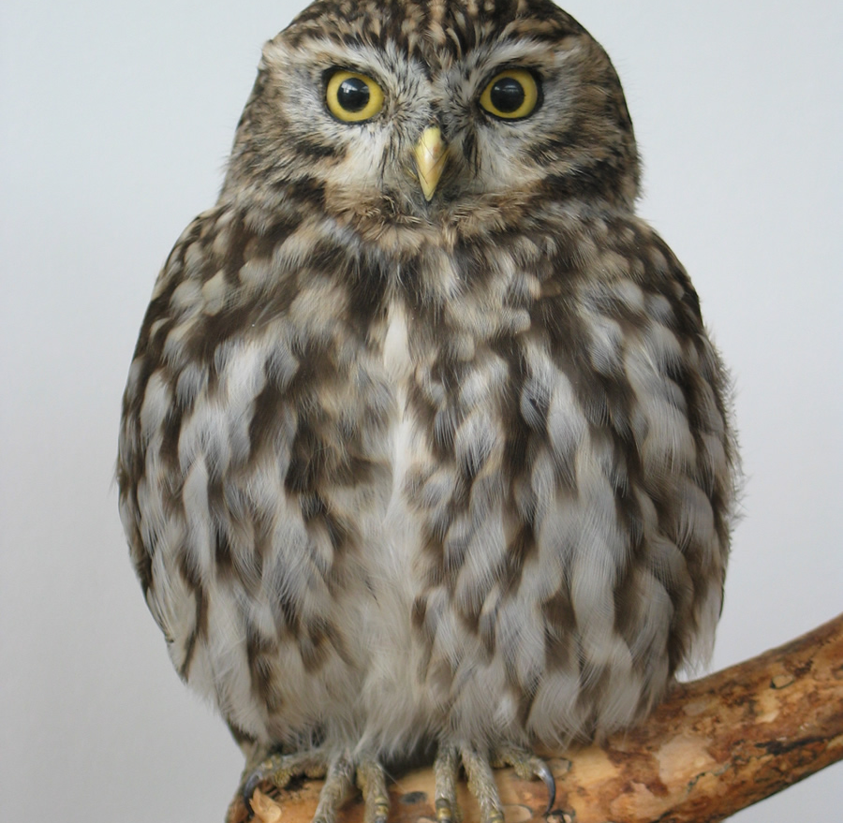
Wisdom
TWO TYPES OF WISDOM
Wisdom of this world | Wisdom from above
Earthly | Heavenly
Sensual / natural | Spiritual
Demonic | Godly

Slide 4
or “A harvest of righteousness”
Wisdom
The fruit of righteousness is sown in peace by those who make peace.
(James 3:18)

Slide 5
Where do wars and fights come from among you?
Do they not come from your desires for pleasure that war in your members?
You lust and do not have.
You murder and covet and cannot obtain.
You fight and war.
(James 4:1-2)
Whose wisdom is this?
What wisdom is this?

Slide 6
You do not have because you do not ask.
Ask, and it will be given to you;
Seek, and you will find;
Knock, and it will be opened to you.
(Matthew 7:7)
You ask and do not receive, because you ask amiss, that you may spend it on your pleasures.
(James 4:3)

Slide 7
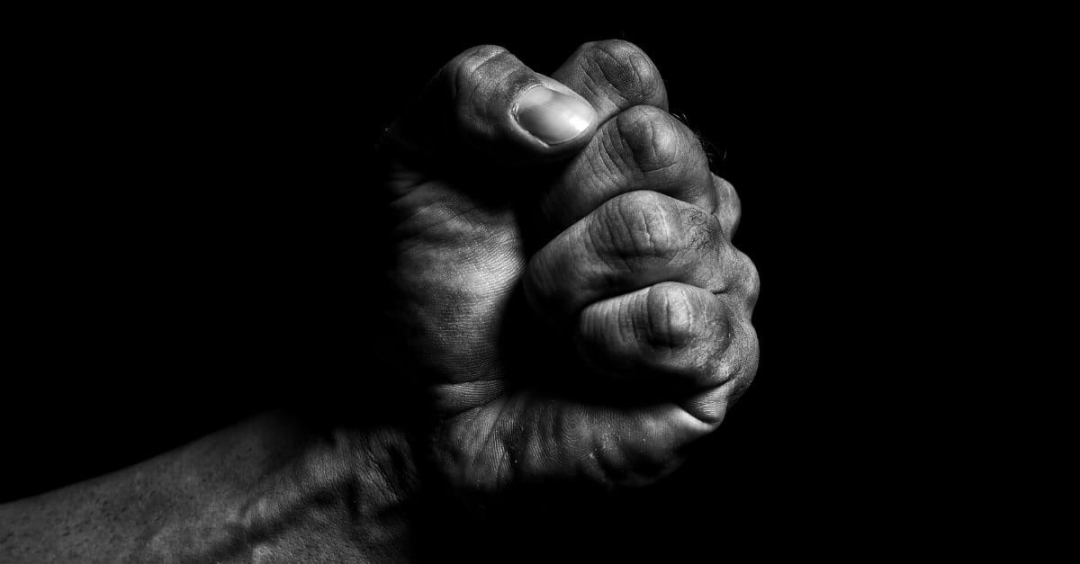
Don’t you know…?
A friend of the world…
…an enemy of God.
Whoever therefore wants to be a friend of the world makes himself an enemy of God.
(James 4:4)

Slide 8
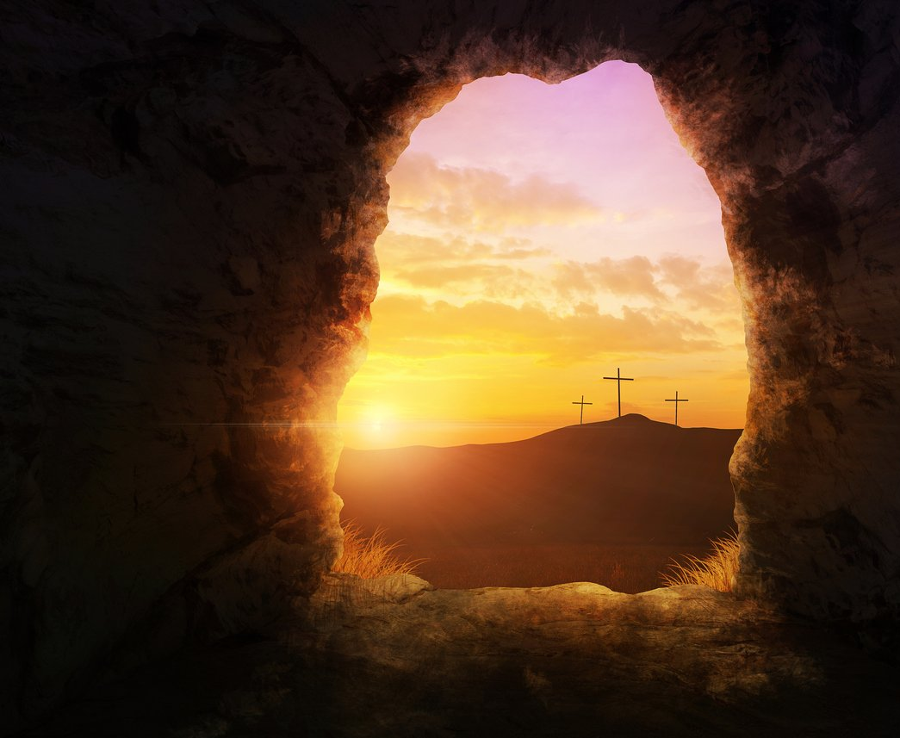
Jesus said:
The world … hates Me because I testify of it that its works are evil.
(John 7:7)
These things I have spoken to you, that in Me you may have peace.
In the world you will have tribulation;
but be of good cheer,
I have overcome the world.
(John 16:33)

Slide 9
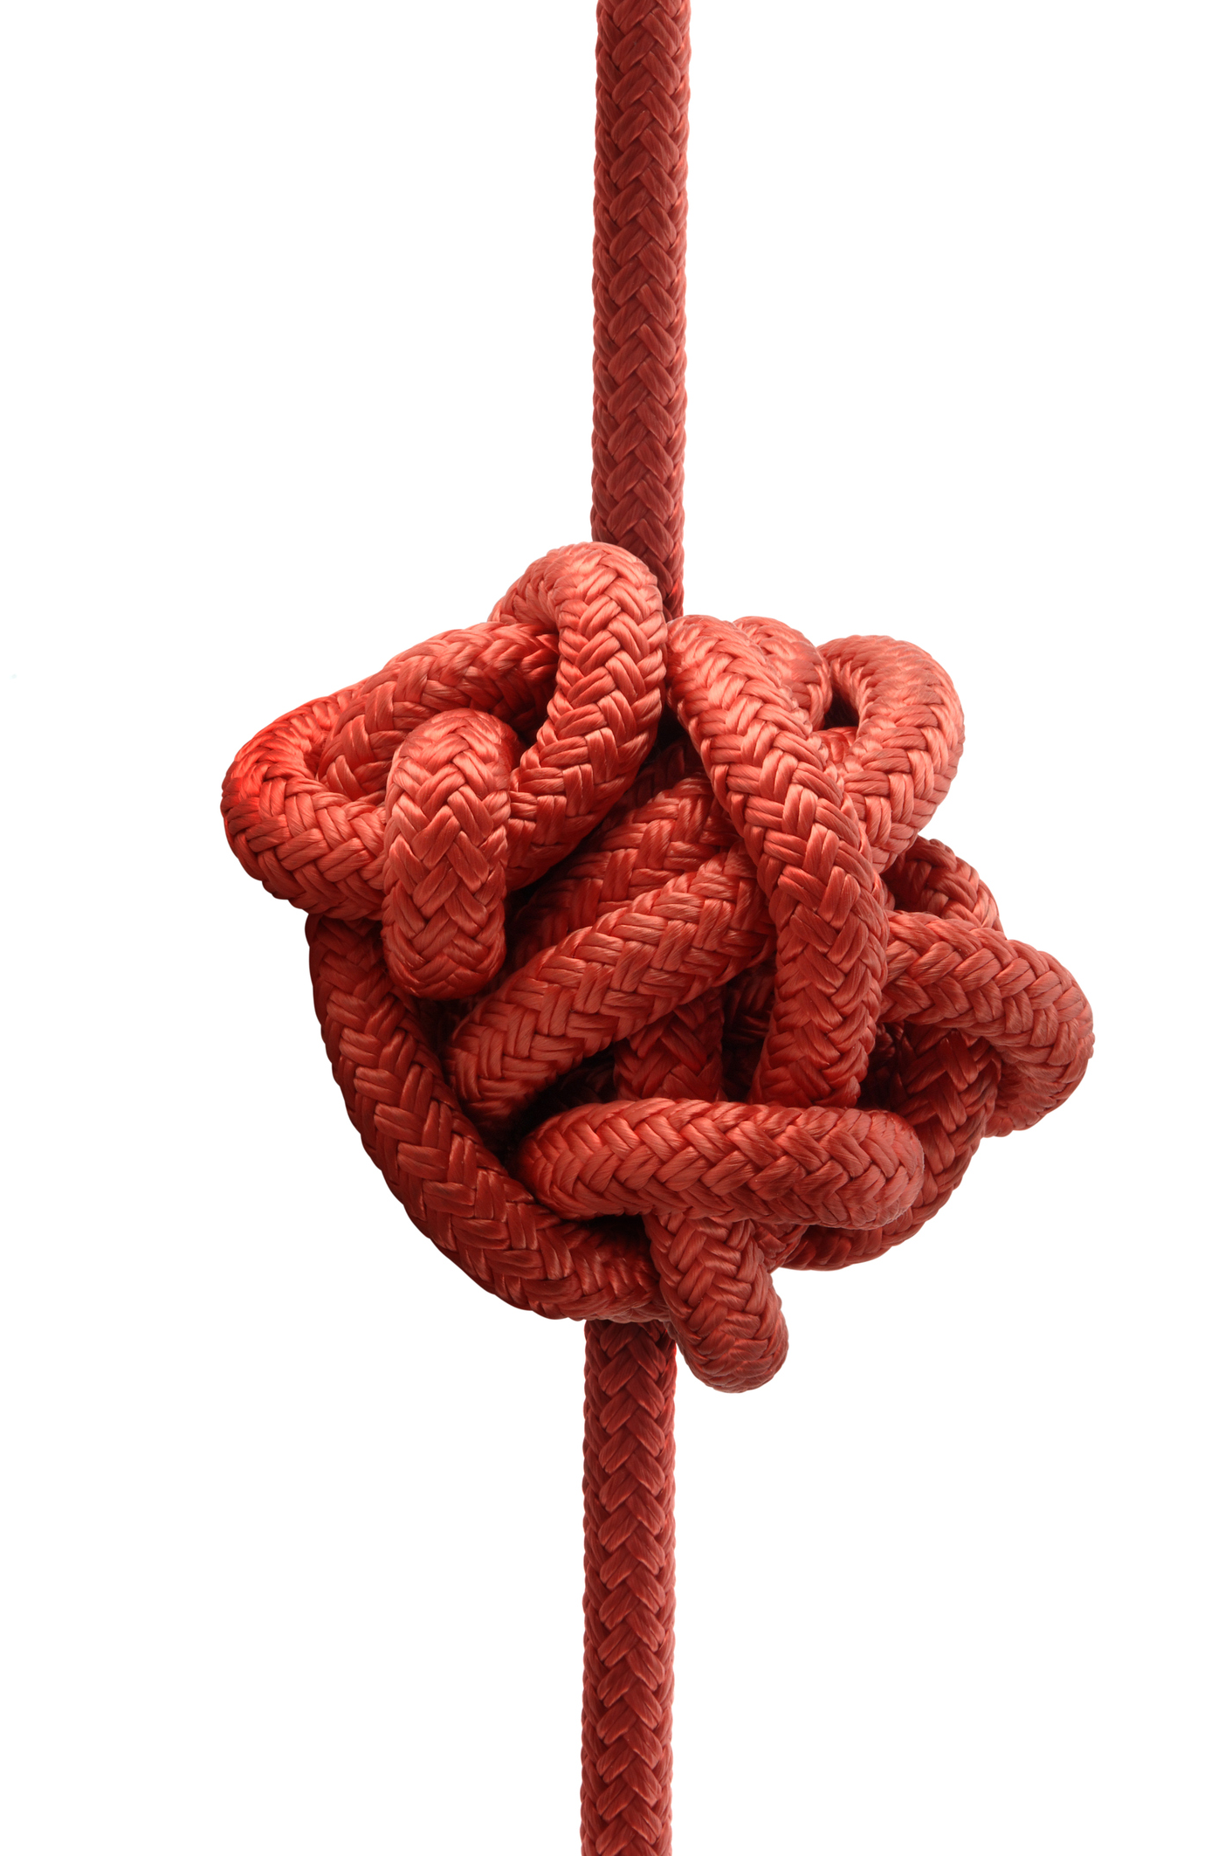
The difficulty of James 4:5
Or do you think that the Scripture says in vain,
"The Spirit who dwells in us yearns jealously"? (NKJV)
Or do you suppose it is to no purpose that the Scripture says,
“He yearns jealously over the spirit that he has made to dwell in us”? (ESV)
He jealously longs for the spirit he has caused to dwell in us (NIV)
The spirit he made to dwell in us envies intensely (CSB)
Does the Spirit which has taken his abode in us desire enviously? (JND)
The spirit that God caused to live within us has an envious yearning (NetB)
The [human] spirit which He has made to dwell in us lusts with envy? (AMP)

Slide 10
But…
But He [God] gives more grace.
Therefore He says:
“God resists the proud, But gives grace to the humble.”
(James 4:6)

Slide 11
Therefore

Slide 12
James 4:7-10
Therefore submit to God.
Resist the devil and he will flee from you.
Draw near to God and He will draw near to you.

Slide 13
James 4:7-10
Therefore submit to God.
Cleanse your hands, you sinners;
and purify your hearts, you double-minded.

Slide 14
James 4:7-10
Therefore submit to God.
Lament and mourn and weep!
Let your laughter be turned to mourning and your joy to gloom.

Slide 15
James 4:7-10
Therefore submit to God.
Humble yourselves in the sight of the Lord,
and He will lift you up.

Slide 16
or turn around, or change direction
Jesus said:
Assuredly, I say to you,
unless you are converted and become as little children,
you will by no means enter the kingdom of heaven.
(Matthew 18:1-4)

Slide 17
But how can I become like a little child?
Jesus said:
Assuredly, I say to you,
unless you are converted and become as little children,
you will by no means enter the kingdom of heaven.
(Matthew 18:1-4)

Slide 18
Towards true humility…
Don’t pretend to be what you are not.
Don’t presume you are right when you can’t be sure.
Don’t push to get your own way.

Slide 19
He gives more grace.
“God resists the proud, But gives grace to the humble.”

